Slide 1
DATA STRUCTURES LABORATORY
Lab Session 7 (queue operations)

Slide 2
Session No. | Programs | Page No.
1 | To find the length of a string To concatenate two strings To copy a string to another string To reverse a string
2 | To generate “n” terms of the Fibonacci series To find the GCD of two numbers
3 | To insert an element at a given position in an array To delete an element from a given position in an array To perform Bubble sort
4 | To perform Insertion sort To perform Selection sort
5 | To perform Linear search To perform Binary search
6 | To perform stack operations
7 | To perform Queue operations
8 | To perform circular Queue operations
9 | To convert Infix expression to Postfix expression
10 | Insertion of elements to a linked list
11 | Deletion of elements from a linked list
12 | To create a binary tree and perform tree traversal

Slide 3
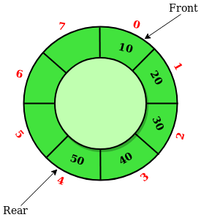
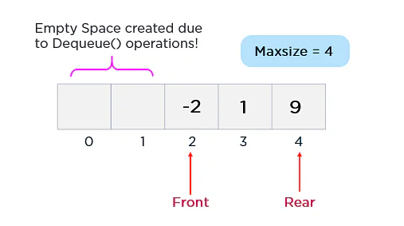
Circular queue
A Circular Queue is a special version of a queue where the last element of the queue is connected to the first element of the queue forming a circle.
The operations are performed based on FIFO (First In First Out) principle. It is also called ‘Ring Buffer’.
Implementation of a linear queue brings the drawback of memory wastage.
In the case of a linear queue, when the rear pointer reaches the MaxSize of a queue, there might be a possibility that after a certain number of dequeue() operations, it will create an empty space at the start of a queue.

Slide 4
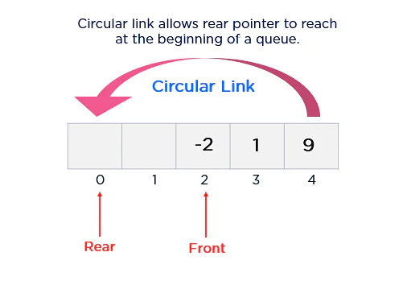
Additionally, this newly created empty space can never be re-utilized as the rear pointer reaches the end of a queue. Hence, experts introduced the concept of the circular queue to overcome this limitation.
As shown in the figure above, the rear pointer arrives at the beginning of a queue with the help of a circular link to re-utilize the empty space to insert a new element. This simple addition of a circular link resolves the problem of memory wastage in the case of queue implementation.

Slide 5
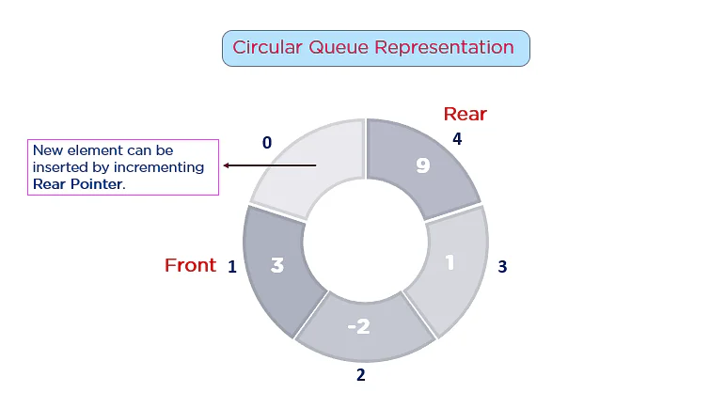
Circular Queue in a Data Structure?
A circular queue is an extended version of a linear queue as it follows the First In First Out principle with the exception that it connects the last node of a queue to its first by forming a circular link. Hence, it is also called a Ring Buffer.

Slide 6
Circular Queue Work?
Operations
Front - Used to get the starting element of the Circular Queue.
Rear - Used to get the end element of the Circular Queue.
enQueue(value) - Used to insert a new value in the Circular Queue. This operation takes place from the end of the Queue.
deQueue() - Used to delete a value from the Circular Queue. This operation takes place from the front of the Queue.

Slide 7

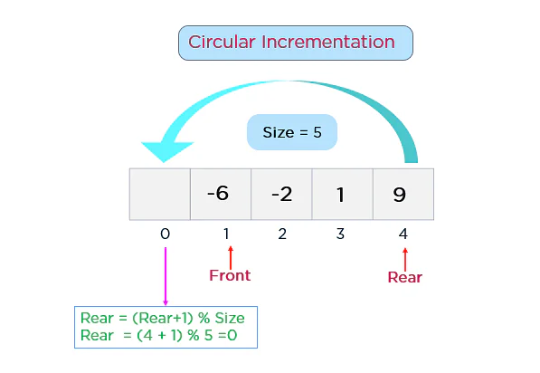
Implementing a circular link is a new addition that you need to execute. Additionally, this queue works by the process of circular incrementation. That is, when you reach the end of a queue, you start from the beginning of a queue. The circular incrementation is achievable with the help of the modulo division.

Slide 8
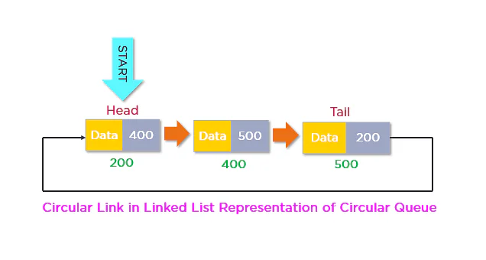
Similarly, the tail node of a linked list can be connected to its head node by adding the address value of a head node in the reference field of the tail node.

Slide 9
Operation
Enqueue(x) Operation
Step 1: Check if the queue is full (Rear + 1 % Maxsize = Front)
Step 2: If the queue is full, there will be an Overflow error
Step 3: Check if the queue is empty, and set both Front and Rear to 0
Step 4: If Rear = Maxsize - 1 & Front != 0 (rear pointer is at the end of the queue and front is not at 0th index), then set Rear = 0
Step 5: Otherwise, set Rear = (Rear + 1) % Maxsize
Step 6: Insert the element into the queue (Queue[Rear] = x)
Step 7: Exit

Slide 10
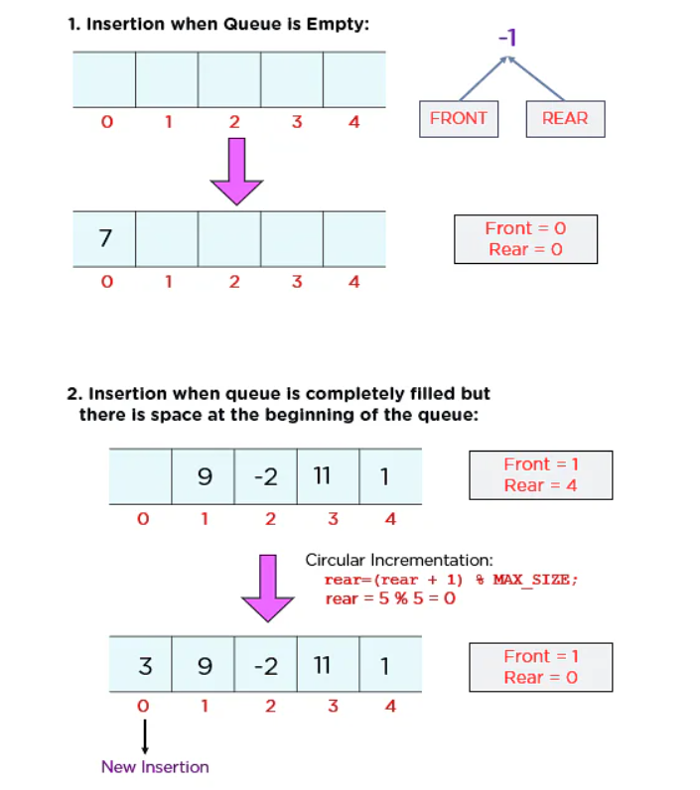

Slide 11
Dequeue() Operation
Step 1: Check if the queue is empty (Front = -1 & Rear = -1)
Step 2: If the queue is empty, Underflow error
Step 3: Set Element = Queue[Front]
Step 4: If there is only one element in a queue, set both Front and Rear to -1 (IF Front = Rear, set Front = Rear = -1)
Step 5: And if Front = Maxsize -1 set Front = 0
Step 6: Otherwise, set Front = Front + 1
Step 7: Exit

Slide 12
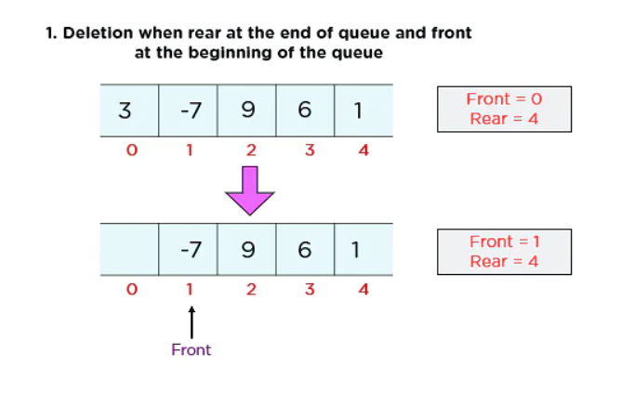
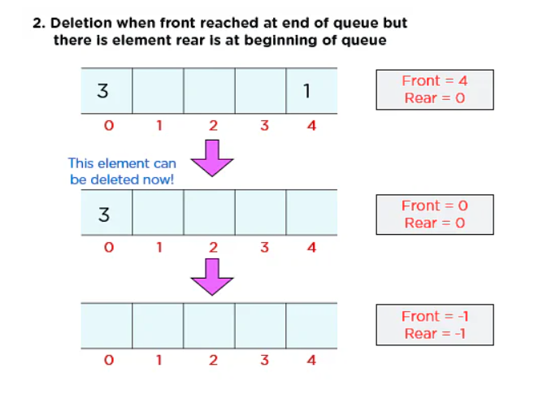

Slide 13
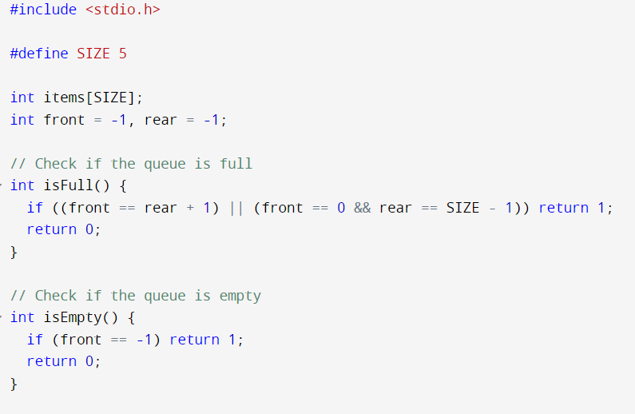
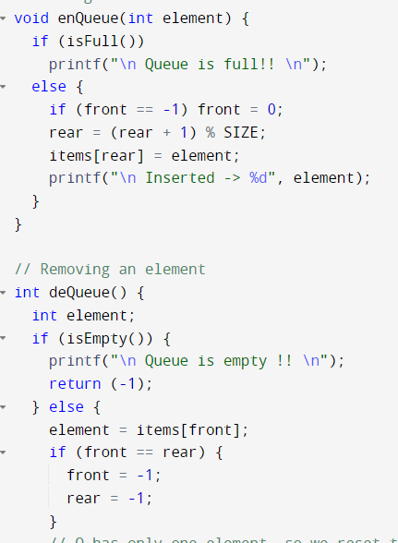

Slide 14
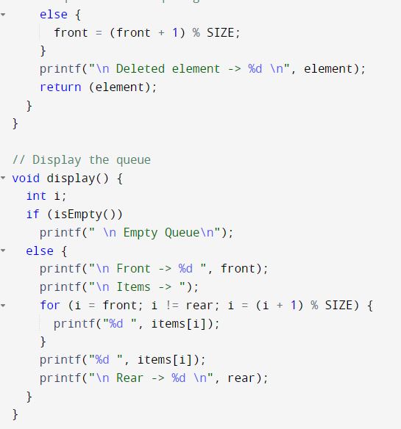
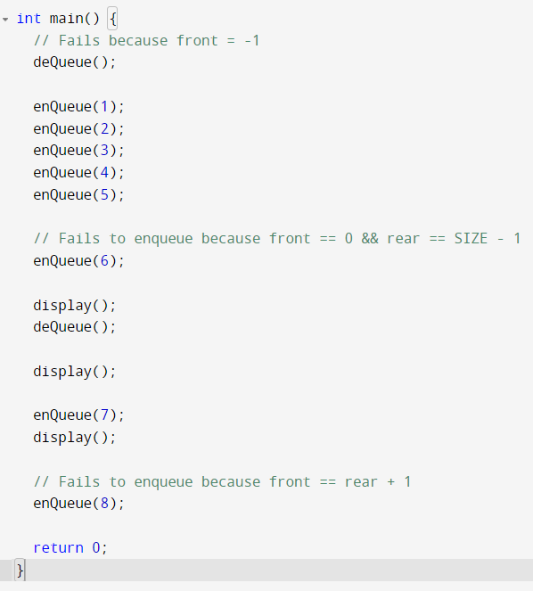

Slide 15
